Slide 1
DensePose

Slide 2
What is DensePose
Facebook
3D surface-based representation
COCO-DensePose
Notes:
Developt by Facebook AI team university -
3d surface based representation of the human body
Made COOC-Densepose dataset that i will talk about later.

Slide 3
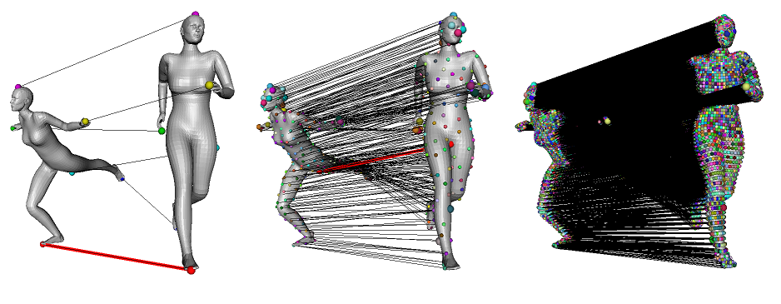
Definition
Dense correspondence
Notes:
Need to do the following:
Object detection
Object segmentation
Pose estimation

Slide 4
DensePose
Establish dense correspondence from a 2d image to a 3d surface-based representation of the human body
Notes:
Problem description
Establish dense correspondence from a 2d image to a 3d surface-based representation of the human body
Split into
Object detection -
Pose estimation -
Part and instance segmentation
Establish dense correspondence from a 2d image to a 3d sureface-based representation of the human body

Slide 5
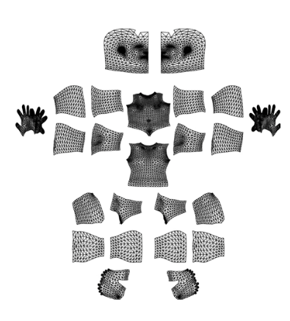
Annotation
COCO- DensePose dataset
Manual annotating 3d models
Each pixel - unique surface coordinate
50 000
Notes:
COCO-DensPose
50 k humans
More then 5 million manually annotaed correspondences.

Slide 6
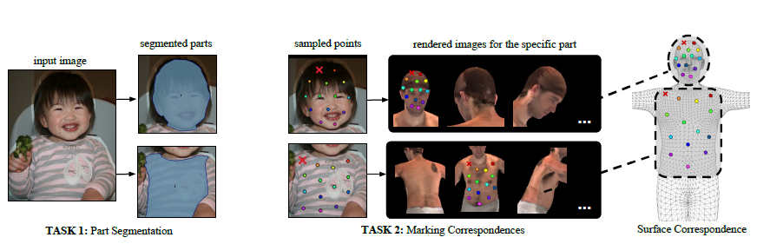
Annotation
From 2d to 3d
Notes:
Used humans to make annotation to establish dense correspondences from 2D images to a surface-based representation of the human body.
Created a annotation pipeline for efficiently gather annotation for image-to-surface correspondence.
The first task for the annotation is to delineate regions corresponding to visible, semantically defined body parts. Such as head, torso, lower/upper arms, lower/upper legs.
For simplifying purposes they design the pars to be isomorphic to a plane, partitioning the limbs and torso into lower-upper and frontal-back parts.
Different techniques for different body parts.

Slide 7
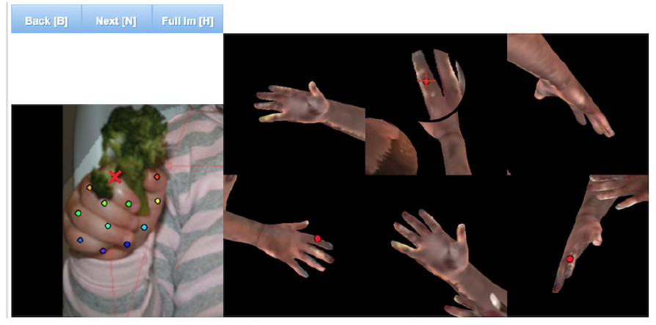
Annotation
Six pre-rendered views of the same body part
Notes:
In order to simplify
this task we ‘unfold’ the part surface by providing six
pre-rendered views of the same body part and allow the user
to place landmarks on any of them Fig. 3. This allows the
annotator to choose the most convenient point of view by
selecting one among six options instead of manually rotating
the surface.
As the user indicates a point on any of the rendered part
views, its surface coordinates are used to simultaneously
show its position on the remaining views – this gives a
global overview of the correspondence.

Slide 8
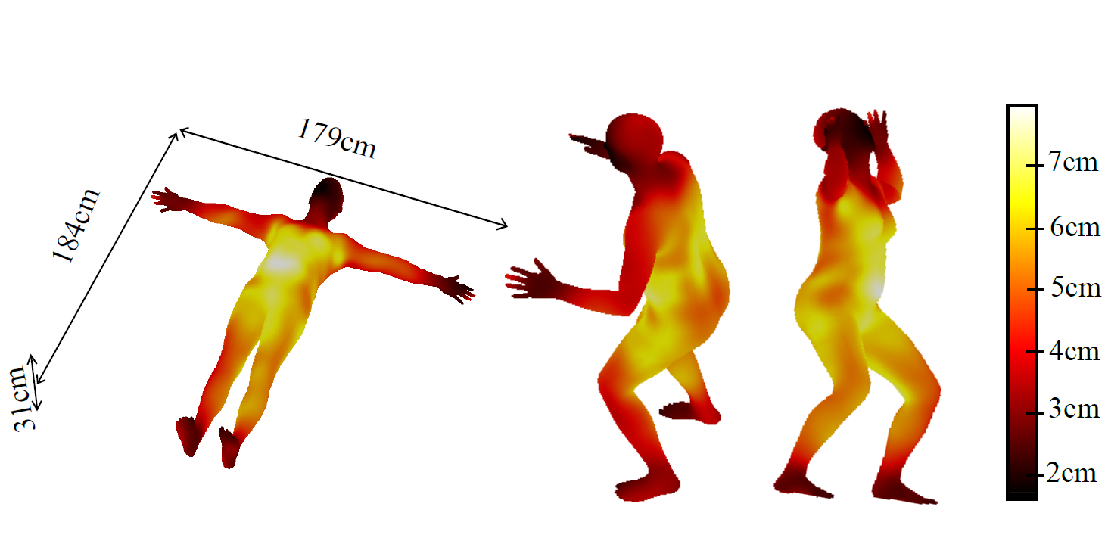
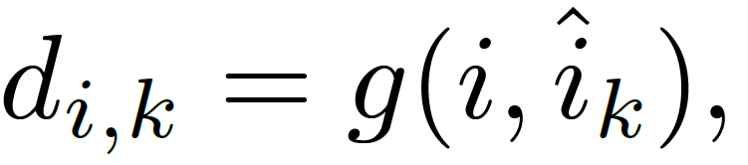
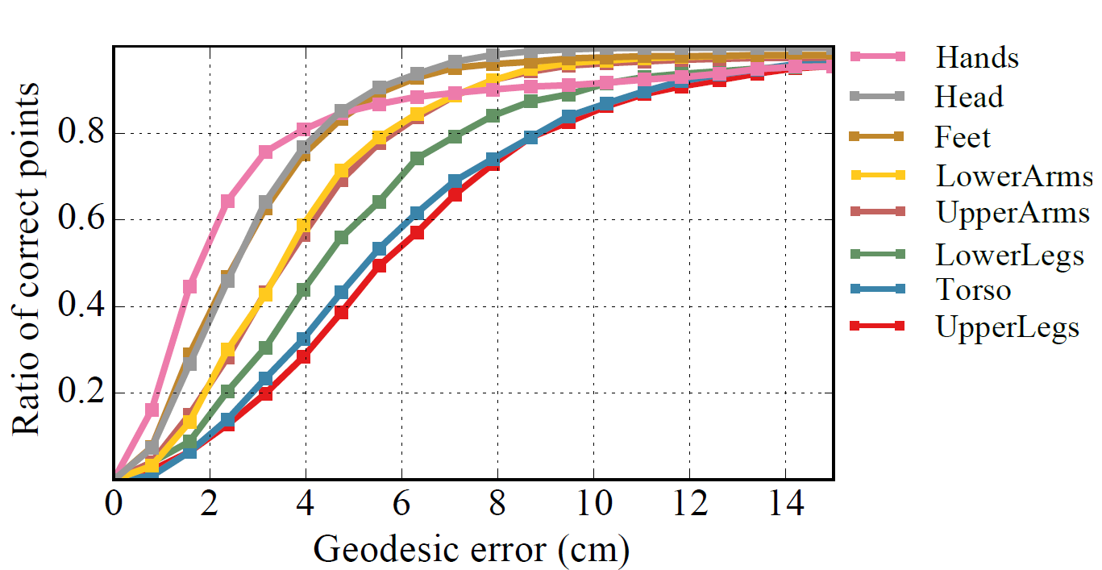
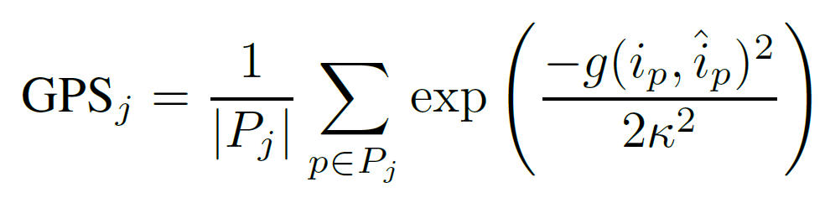
Annotation
Pointwise evaluation
Ratio of correct point
AUC
Per-instance evaluation
Geodesic point similarity
Notes:
When annotating, images that are rendered are mixed in with the rest of the images. In this way they can use the rendered pictures when calculating the error for the annotators.
Accuracy of human annotators
They know the true mesh coordinates used to render a pixel. That means that they know the position for each pixel in the picture. They compare this true value with the estimated value by the annotators.
Small errors on small surface parts with distinctive features that could help localization, while on larger more uniform areas that are typically covered by clothes the annotator error can get larger as we see in this picture.
D mesaures the geodistance between the real point and the estimated point from the anotators. The error is then the average of the distance for the given point. The geodistance follow the surface of the skin. Example.
Pointwise evaluation:
Evaluates correspondence accuracy over the whole image domain through the Ratio of correct point. Correspondence is correct if the geo distance is under a given threshold. This threshold varies, and gives us a curv. Evaluate the area under the CURV (AUC) for two different values.
AUC10
AUC30
AUC10 is understood as being an accuracy measure for more refined correspondence.
Per-instance evaluation
Introducing the geodesic point similarity.
Takes the geodesic distance for each point in the instance (hand, feet, head etc) and take the average of this and scaling the number to be between 0 and 1. This score tells us how good the correspondence is. With a score of 0.5 its a perfect instance, in other word. It is a hand and not a foot. With higher scores we get more and more accuracy for the points.
Pj is the set of ground truth point

Slide 9
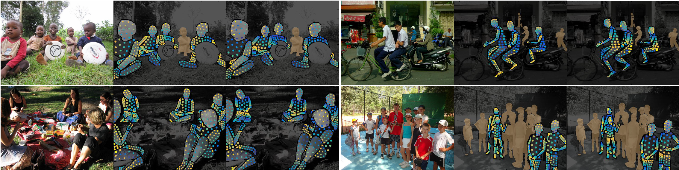
Annotation
Visualization of the annotation
Image - U representation - V representation
Notes:
The image points
are presented to the annotator in a horizontal/vertical succession,
which makes it easier to deliver geometrically consistent
annotations by avoiding self-crossings of the surface.
This two-stage annotation process has allowed us to very
efficiently gather highly accurate correspondences.

Slide 10
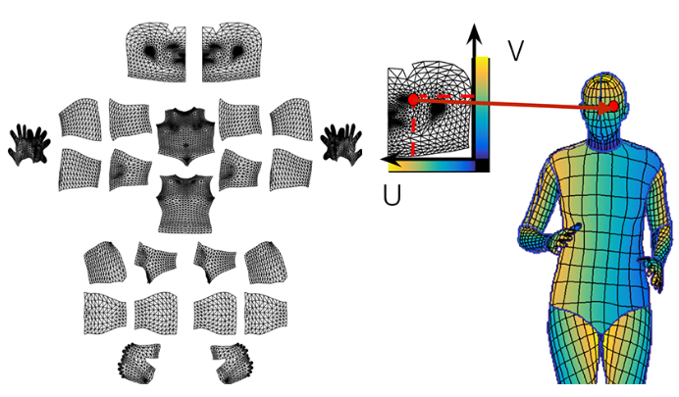
Notes:
So to sum up the annotation.
So for each pixel they need to determine two things
Which surface part it belongs to
Where on the 2d parameterization of the part it corresponds to.
So to the right we have the partitioning of the surface of a human. Each bodypart partioning and flattend out to a 2d surface. Then we have the result from the U V annotation and this point corresponds to a point on a part of the human body as we see on the left.

Slide 11

Model
Fully convolutional network
One network to rule them all.
Region-based Dense Pose Regression
Based on Mask-RCNN
Multi-task cascaded architectures
Distillation-based ground-truth interpolation

Slide 12
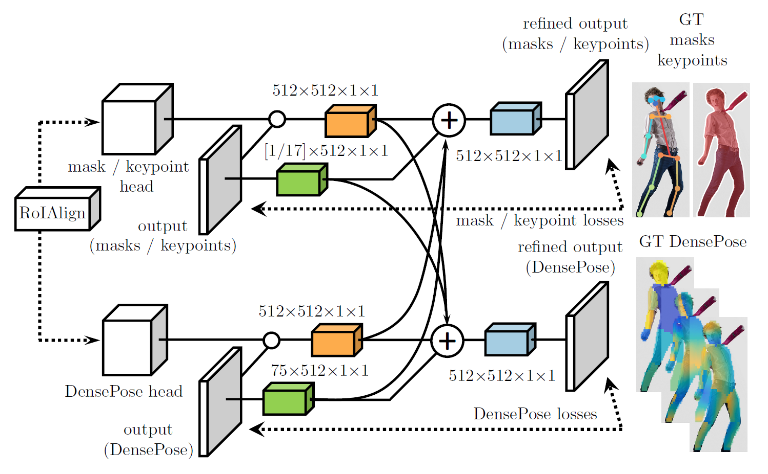
Multi-task cascaded architectures
Notes:
Cross-cascading architecture: The output of the RoIAlign module feeds into the DensePose network as well as auxiliary networks for other tasks. Once first stage predictions are obtained from all tasks, they are combined and then fed into a second-stage refinement unit of each branch.

Slide 13
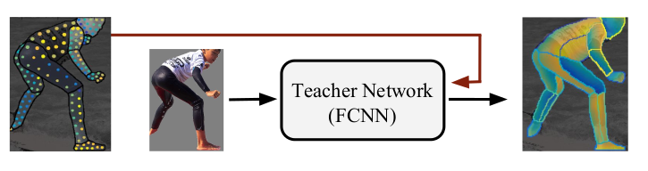
Distillation-based ground-truth interpolation
Notes:
In the distillation-based ground-truth interpolation method they use a teacher network to interpolate the points between the collected ground truth points. These dense supervision signals are then used in the training, giving better results than only using the collected sparse points.

Slide 14
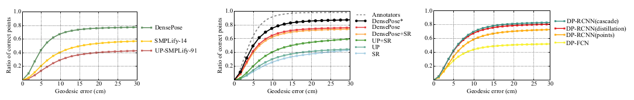
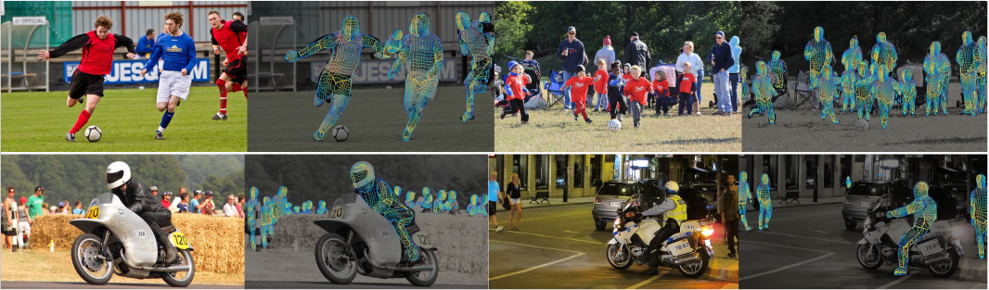
Results
Notes:
First figure: DensePose vs SMPLify. SMPLify creates skeletons from singular pictures, limited to one per picture.

